Slide 1





Conciseness, interest, and unexpectedness: user attitudes towards infographic and comic consent mediums
Xengie Doan
SnT, University of Luxembourg
xengie.doan@uni.lu
Annika Selzer
Fraunhofer SIT
Arianna Rossi
SnT, University of Luxembourg
Wilhelmina Maria Botes
SnT, University of Luxembourg
Gabriele Lenzini
SnT, University of Luxembourg
COnSeNT Workshop April 26th, 2022
Notes:
General RQs

Slide 2
Introduction

Slide 3
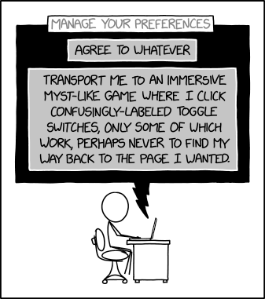
Consent is Complicated…
Consent challenges
Readability
Understandability
Engagement
Transparency
https://imgs.xkcd.com/comics/manage_your_preferences.png

Slide 4
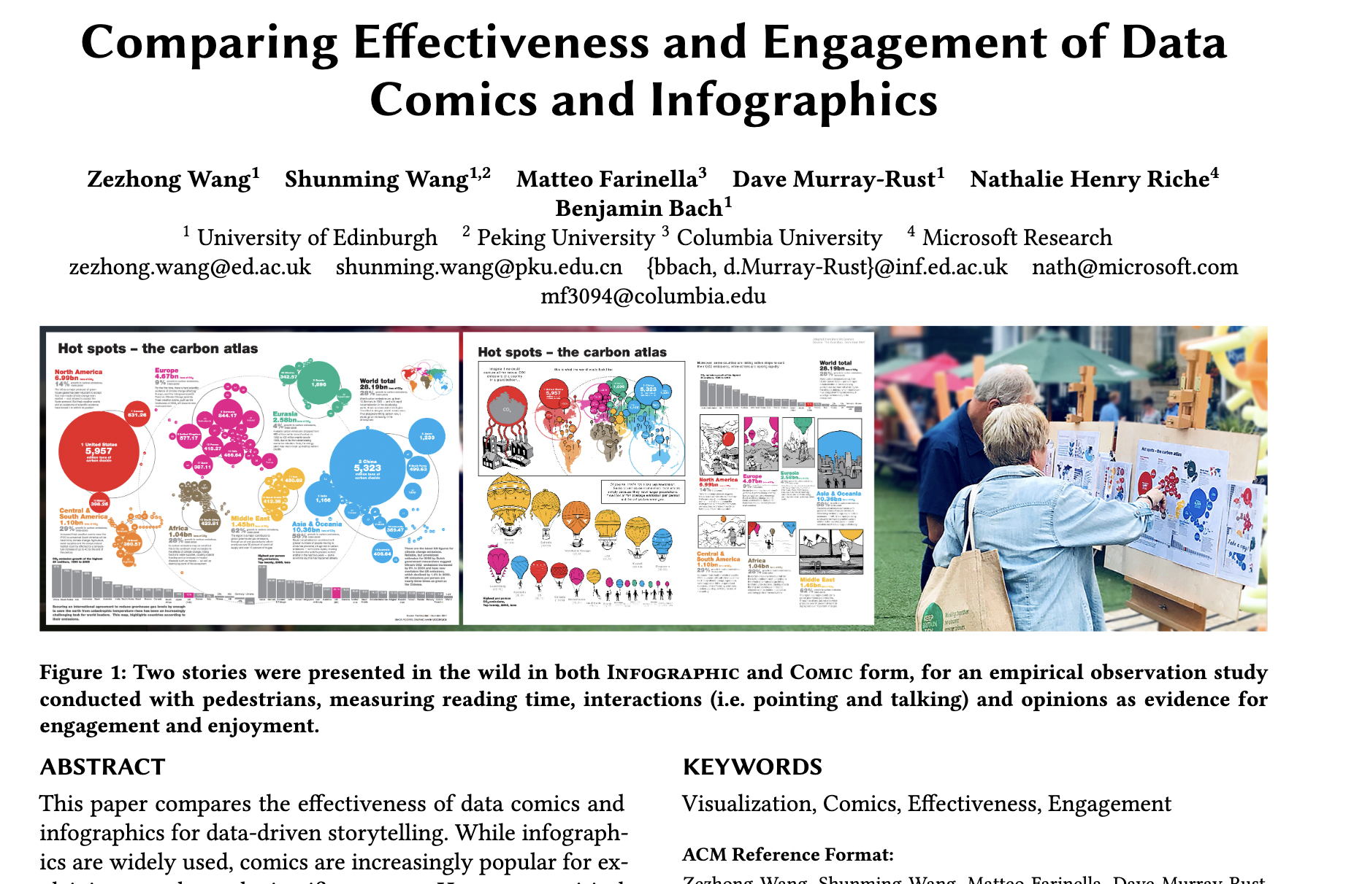
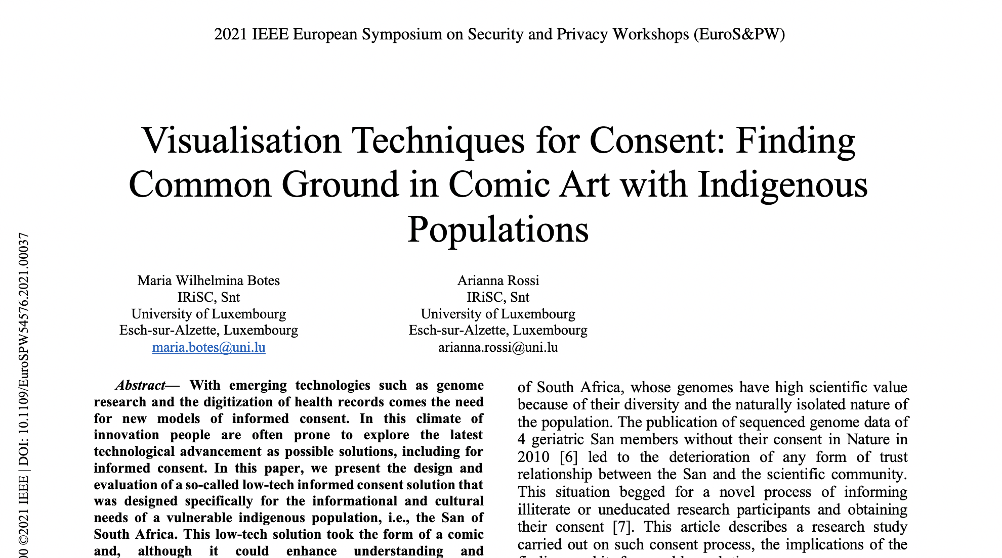
Other Mediums May Help Understanding
Comics, infographic, video, etc.

Slide 5
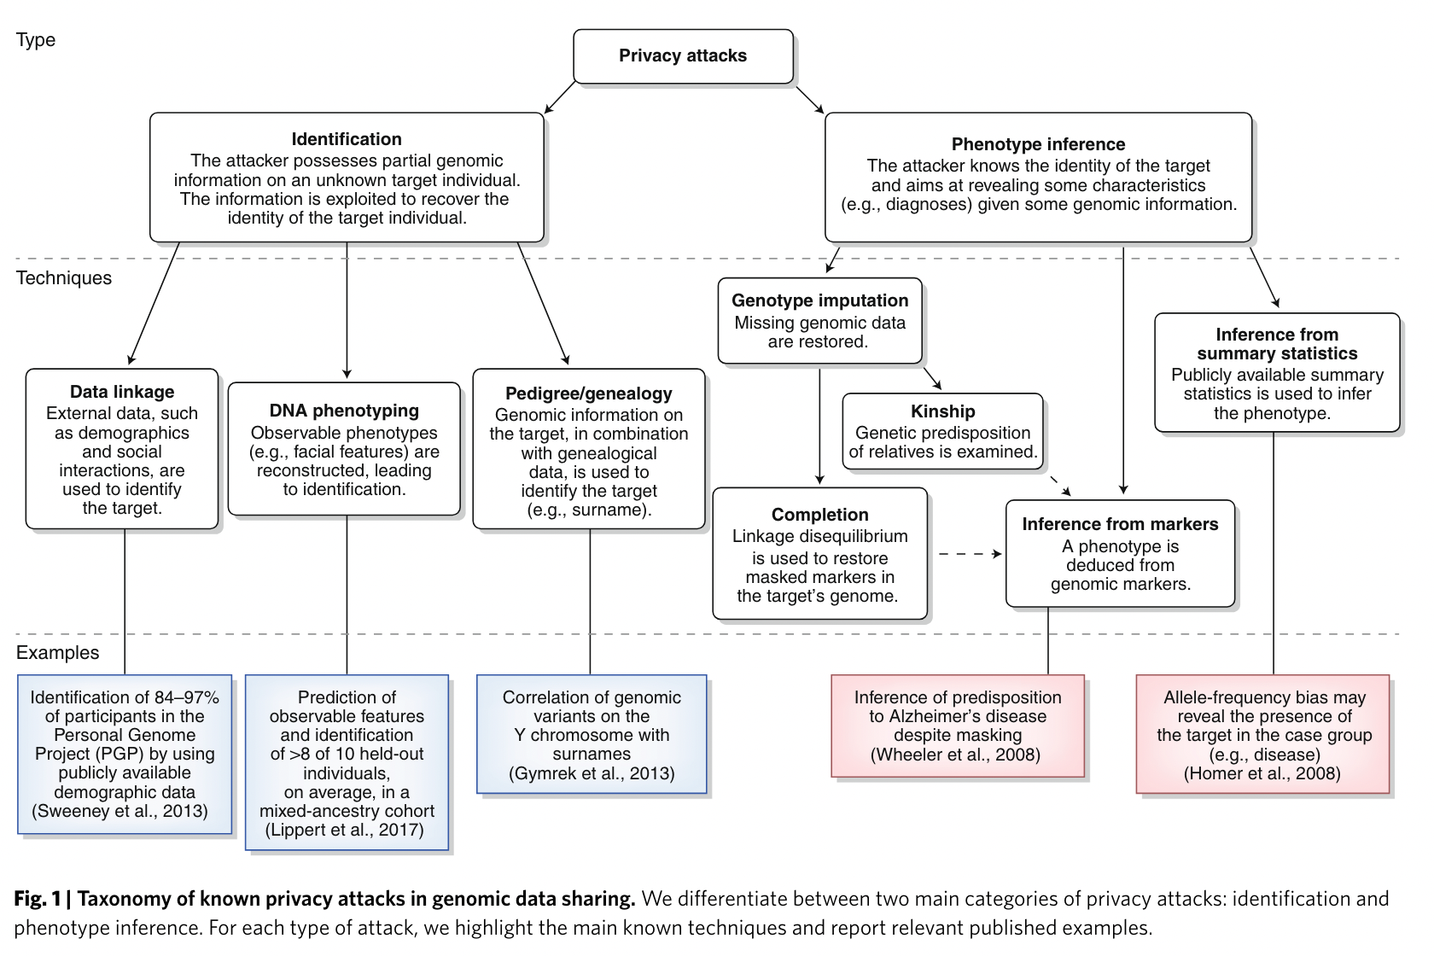
Consent is Important for Health Data
Health data sensitivity
Privacy and identifiability
Understanding risks and benefits which directly impacts people
L. Bonomi, Y. Huang, and L. Ohno-Machado, “Privacy challenges and research opportunities for genomic data sharing,” Nat Genet, vol. 52, no. 7, Art. no. 7, Jul. 2020, doi: 10.1038/s41588-020-0651-0.
Notes:
Many privacy risks!

Slide 6
EU Data Trustees Can Uncomplicate Things for Health Data
Data trustees
Independent party between those who provide data and those who process that data
EU Strategy for Data
Data Governance Act
Health Data Space
Data trustees can assist in finding suitable participants for clinical trials in a privacy-friendly manner
Individuals can transfer their data to a data trustee in exchange for various benefits that passes them on to organizations that intend to carry out clinical trials

Slide 7
Research Questions

Slide 8




RQ1: What are participants’ general experiences with informed consent processes?
Notes:
Exploratory study of user attitudes to answer RQ1:
Add image

Slide 9
RQ2: Considering language, design, content, and document fit with the reader:
What are participants’ expectations prior to exposure to different consent mediums?
What are their preferences after exposure to consent in the infographic and comic mediums and why?
What elements reportedly influence their engagement with the infographic and comic mediums?
What kind of emotions do the infographic and comic mediums trigger?

Slide 10
Methods
Semi Structured Interview
60 – 80min sessions
Demographics:
24 German adult participants with an even representation of:
ages (18-30, 31-55, and 56-90)
female and male sex
highest degree was a school-leaving certificate or a finished apprenticeship and highest degree was from a college or university.
Notes:
The sample was meant to gain a broad perspective of a cross-section of the German adult population across age, sex, and education level.

Slide 11
Study Design
Verbally presented a fictional use case where participants imagine that they were contacted by a data trustee to obtain consent for the transfer of their data to a service provider who wants to invite them to a clinical trial.
Presented with full consent text
Asked about previous experiences with consent and expectations.
Shown subsection of consent form in 5 different mediums and asked for rankings, emotions, and if expectations were met.
Notes:
Tested 5 differen

Slide 12
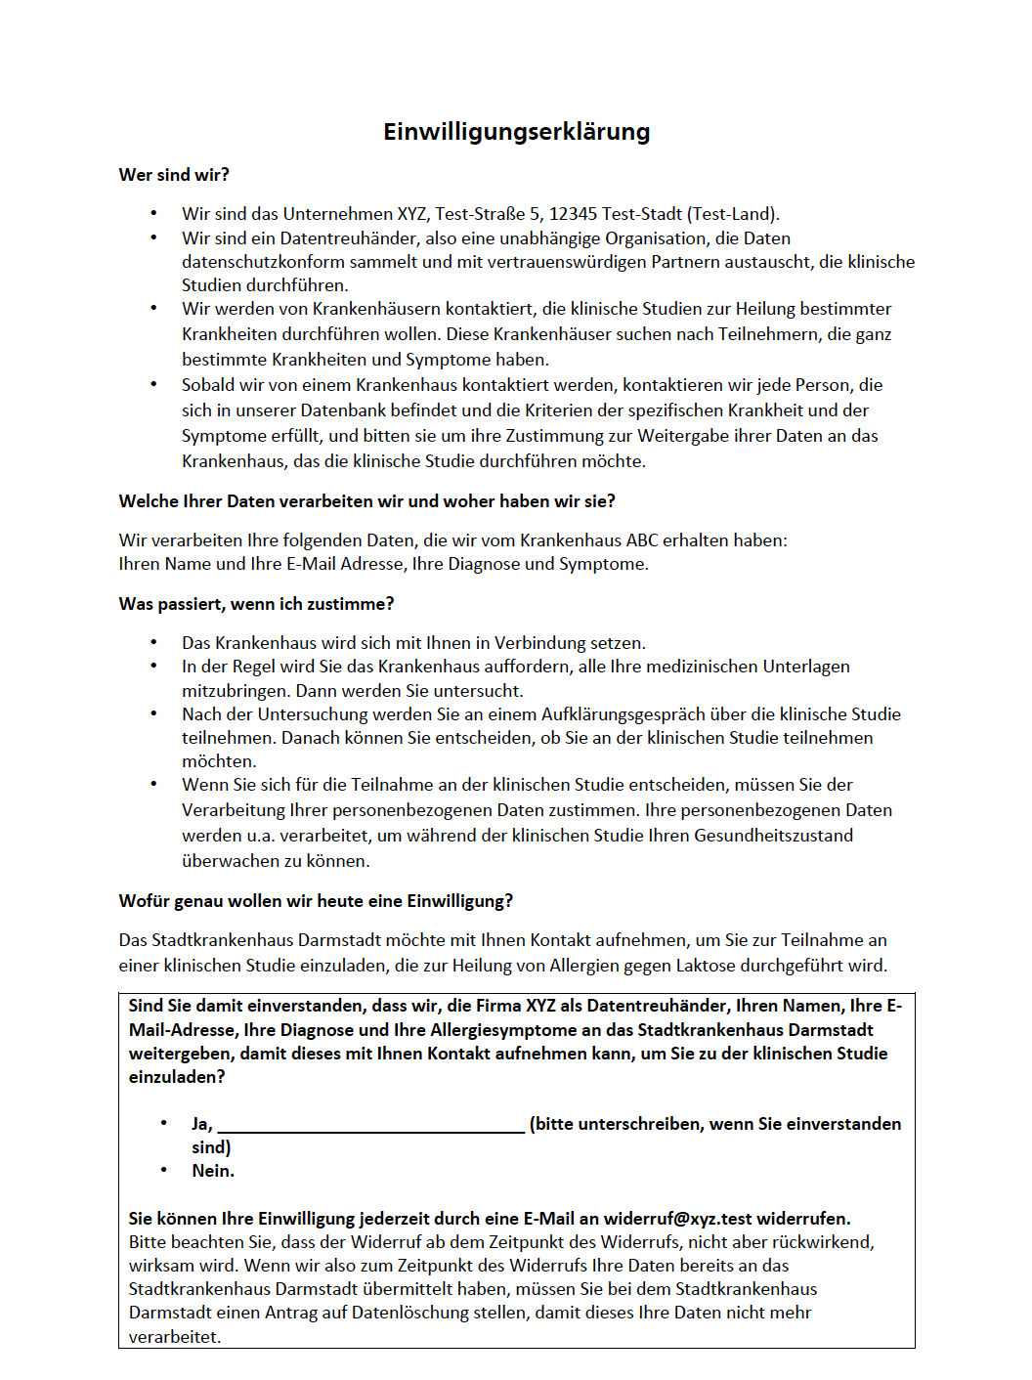
Full Consent Text
Who are we?
What data do we process and where do we get it from?
What happens if I agree?
What exactly do we want consent for today?
Notes:
Highlight that just this section is used for time reasons

Slide 13
Infographic
Highest ranked by participants

Slide 14
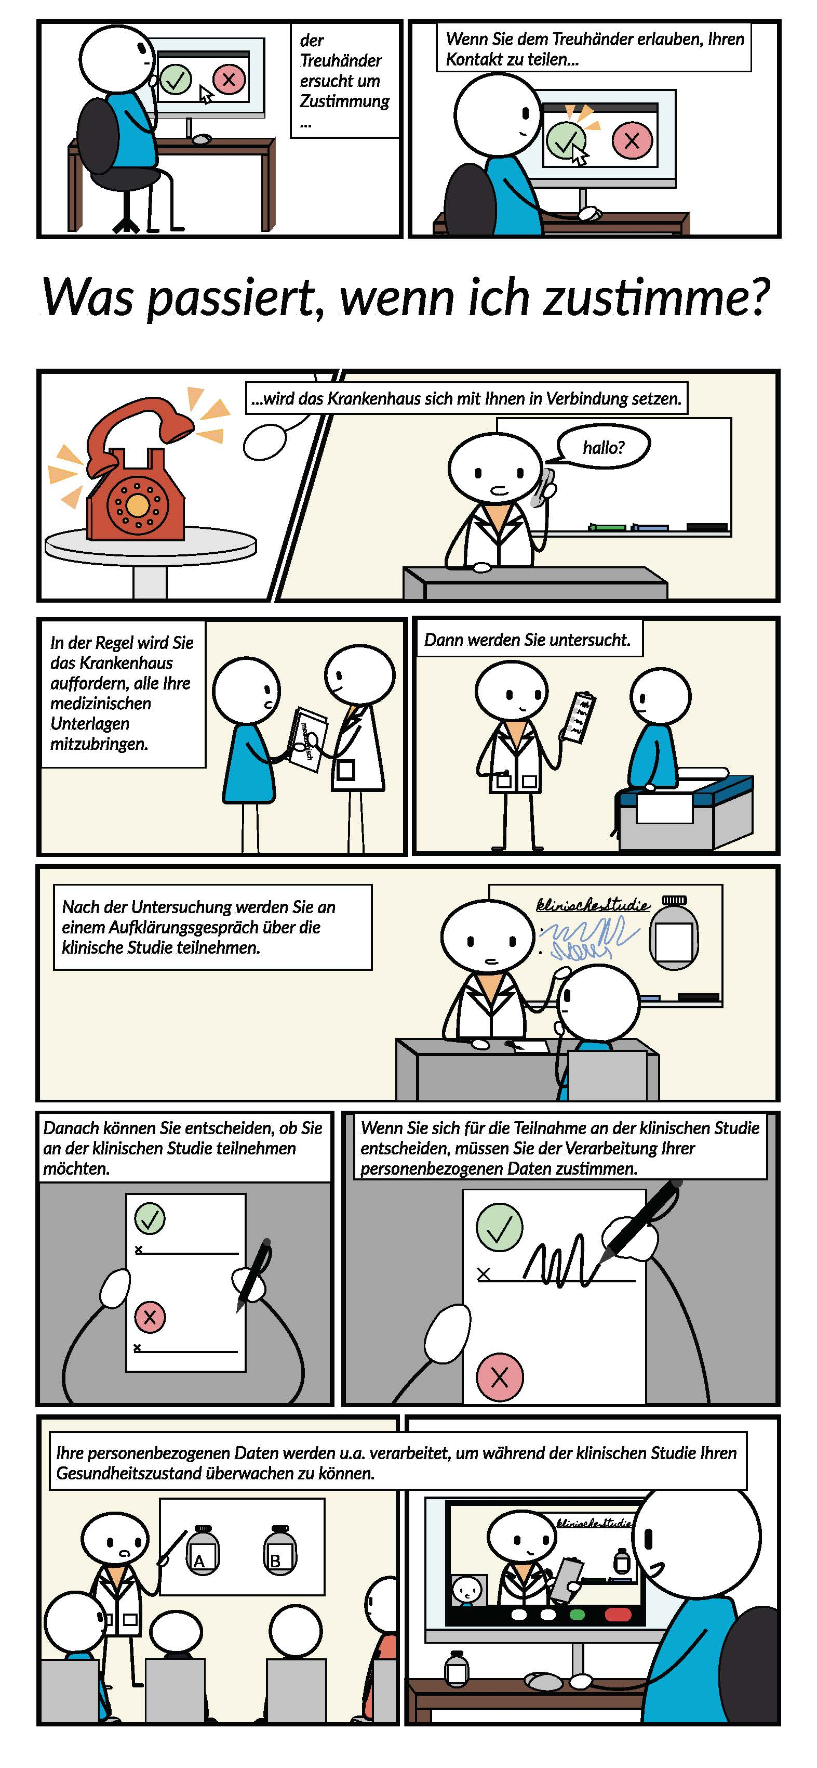
Comic
Lowest ranked by participants

Slide 15
Results

Slide 16
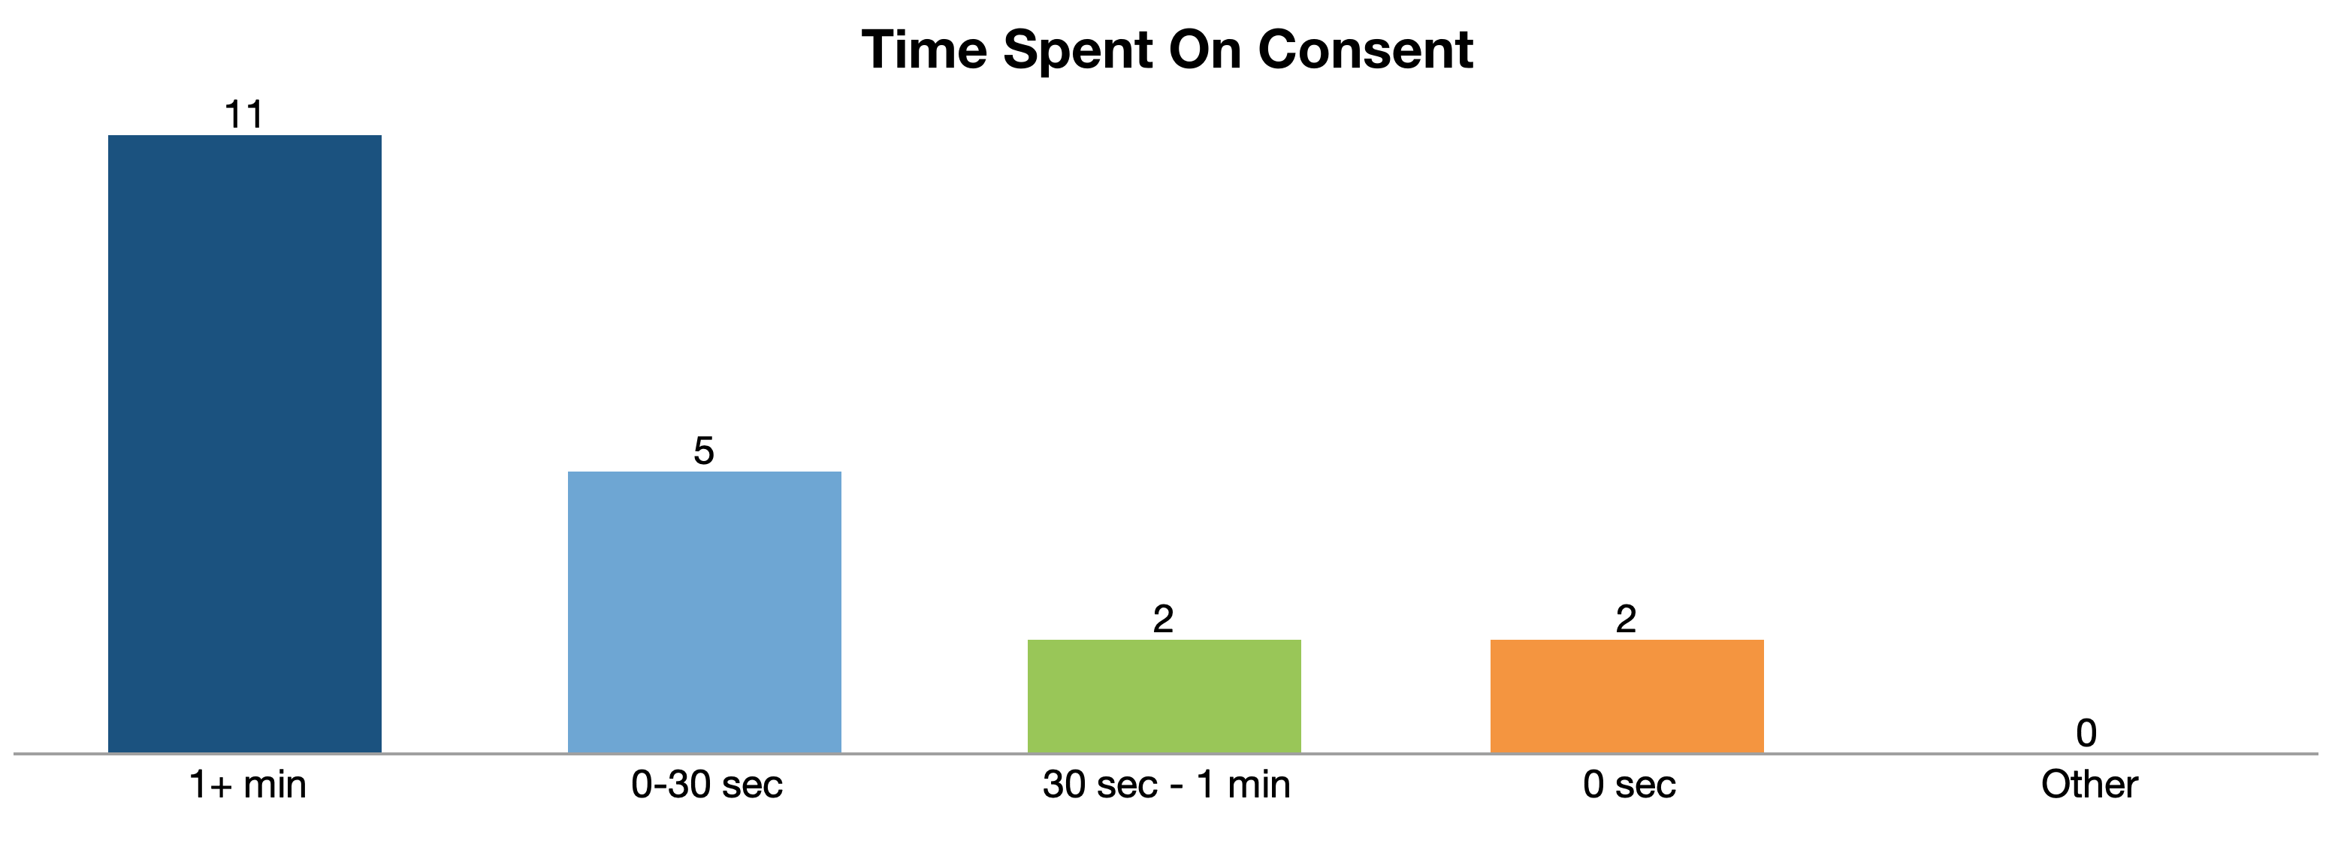
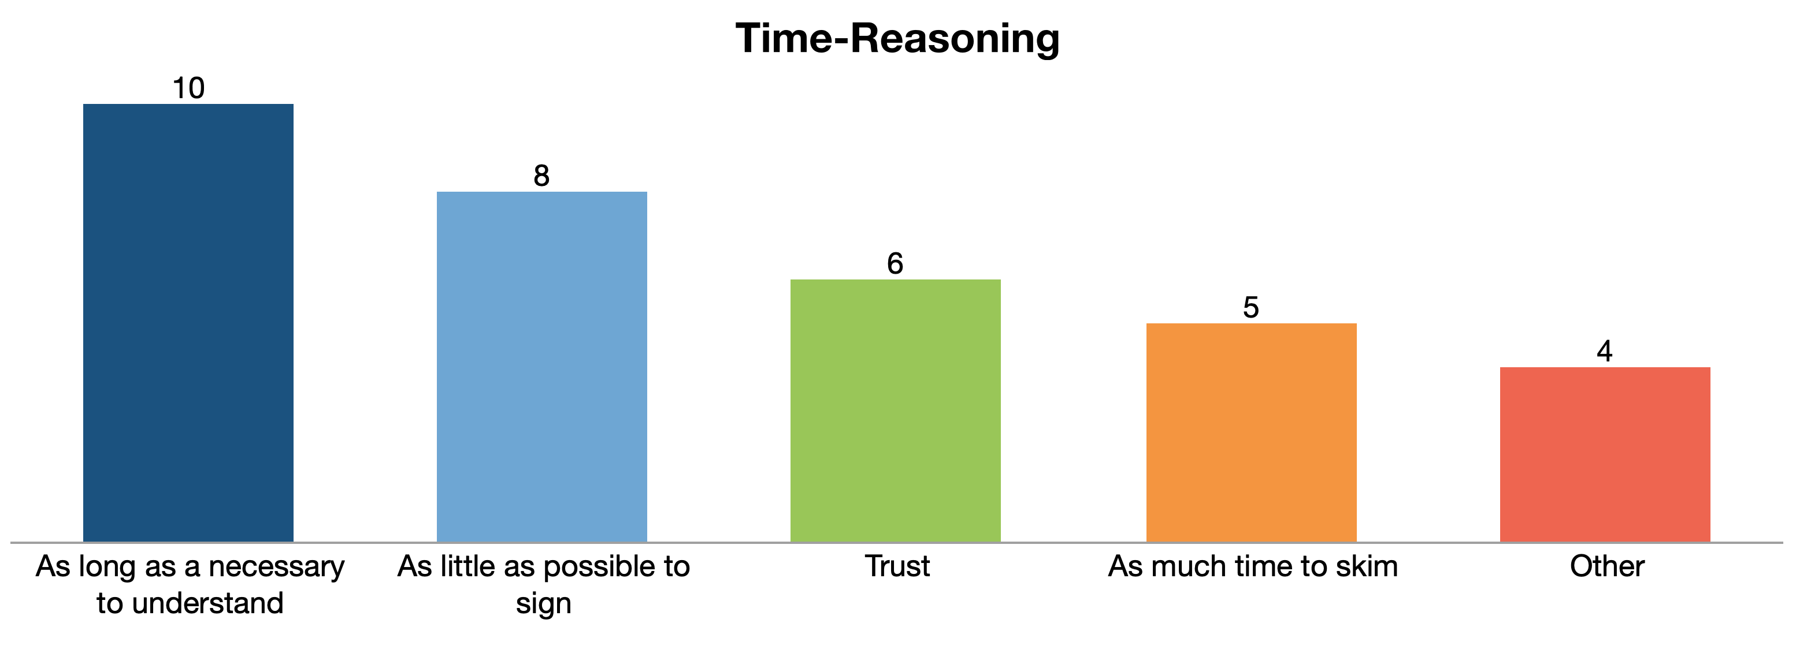
Prior Experience with Consent
n=20
Most time spent on consent 1-5min
Context “With cookies, I immediately refuse as much as possible. At the doctor’s office, for example, I would read through a consent form twice.” (P19)
Top reasoning: as long as necessary to understand
1-5 min
n=33

Slide 17
Expectations for Consent
Graphic elements like bullet points, highlighting, and headings (n=19) for skimming
Textual directness and conciseness of sentences (n=21) for readability
Fit to audience skills and demographics (n=12) for the German adult population
Relevant information for participant (n=10) for prioritization
Notes:
For skimming as we will see later
Readability -

Slide 18
Preferences for Infographic vs Comic
n=48
n=24

Slide 19
Cons of the Comic
Comic dislikes: Most in the relationship criteria (n=24) in particular the audience fit (n=10) and tone (n=8)
“I’m out of the age where I still like comics. [...] I don’t feel like I’m being taken seriously as a customer with a consent form like this” - P16
Notes:
Maybe put into table?

Slide 20
Emotions
Comic: top 3 emotions are surprise, disapproval, interest, and distraction
Infographic: Anticipation, interest, acceptance, and surprise are the top 4 (acceptance and surprise were tied)
Notes:
Both show potential for interest and surprise, but surprise can be positive and negative, and other emotions pull more positive and negative for each one
Comics more negative
Infographic more positive

Slide 21
Limitations
Sample Size
Study materials
Design
Text
Self-reporting

Slide 22
Future work
Contextual appropriateness is important!
Move from recommendations for UI to integrate technical automation with consent technologies
Analyzing full interview (text, comic, infographic, newsletter, and video) for future publication
Notes:
Show the other mediums

Slide 23
Conclusion
Infographic appears to be the most promising medium in a biomedical context as it enables understanding, allows prioritization when reading and raises interest and attention.
The comic, despite some positive elements, should be employed with caution as the audience fit and tone may be experienced as inappropriate for the context of medical consent in Germany.

Slide 24




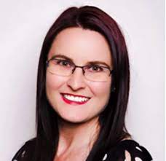

Thank you!
Annika Selzer
Arianna Rossi
Wilhelmina Maria Botes
Gabriele Lenzini
Giusi Abagnale and Ines Geissler for their assistance in the interview documentation.
Funders :
Luxembourg National Research Fund (FNR) Grant Agreement IS/14717072 “Deceptive Online (Decepticon)”
German Federal Ministry of Education and Research and the Hessen State Ministry for Higher Education, Research and the Arts within their joint support of the National Research Center for Applied Cybersecurity ATHENE.

Slide 25
Study Materials
Notes:
Optional to mention: Additional mediums were shown: video, newsletter, text again, but not analyzed in todays presentation

Slide 26
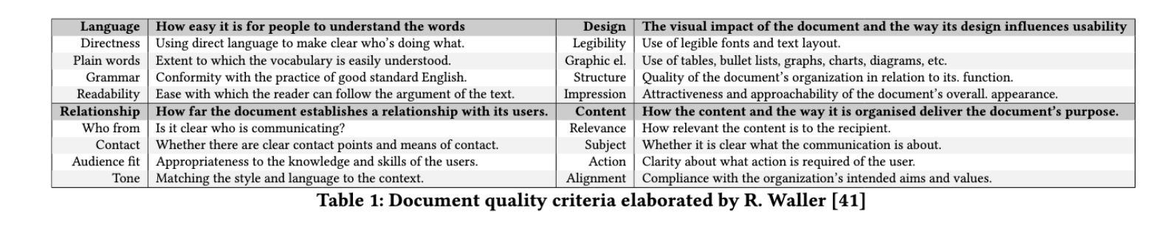
Waller’s document criteria
Notes:
Optional if its useful, or in some other way

Slide 27
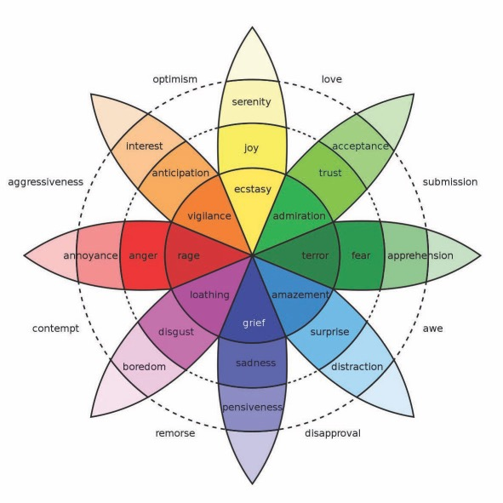
Emotion Wheel
Notes:
Optional if its useful, or in some other way

